Slide 1
Towards Research for Beginners: A case Study
講者：Sheng-Lung Peng
日期：2025/04/22
學生：郭家珍

Slide 2
Outline
01
Review
02
Keywords
03
References

Slide 3
Review
在這場演講中，講者提到了如何進行研究。對我來說，最困難的部分就是「起點」，如何在茫茫學海中找到自己感興趣的領域並發現值得探究的問題。這需要花費大量的時間與精力去摸索與尋找。然而，一旦找到方向後，一切就會變得比較清晰，也會開始對某些議題產生好奇心。這種好奇心就像是一股驅動力，促使我深入了解該領域的相關技術與研究內容。而研究的真正價值，也正是在於從中發現問題並設法解決它們。
透過這次的演講主題分享，我對學術研究的實作方式有了更清楚的認識。其中，讓我印象最深刻的是講者最後的勉勵：在追求真理的路上或許不容易，但最重要的是要相信自己，所有困難都可以克服的。我也期許自己在接下來的研究旅程中，能夠越來越得心應手。

Slide 4
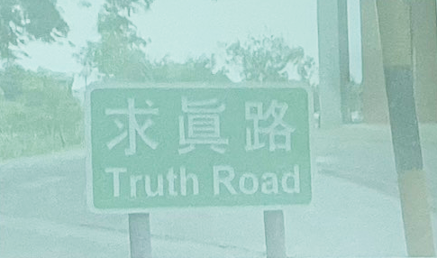

Keywords- Research
Doing research is on the way towards the truth road.
Research is a road for finding truths (new knowledge).
Research is also a road for solving problems.

Slide 5
Keywords- Research
A Scientific Method for Solving Problems
Comprehensive version
Abbreviated version
Observation
Recognition
Definition
Hypothesis
Prediction
Experiment
Observation
Understanding the Problem
Hypothesis / Prediction
Computational/Design Thinking
ㆍExperiment
Algorithm Proof, Analysis, Implementation (for simulation)

Slide 6
Keywords- Research
A Scientific Method for Solving Problems
01
Observation
Observation is the first step of the Scientific Method. However, it can infitrate the whole scientific process - from the initial perception of a phenomenon, to proposing a solution, and ght down to experimentation, where observation of the results is significant.
02
Hypothesis
In scientific discipline, a hypothesis is a set of propositions set forth to explain the occurrence of certain phenomena. In daily language, a hypothesis can be interpreted as an assumption or guess.
03
Experiment
In scientific discipline, an experiment is a test under controlled conditions to investigate the validity of a hypothesis. In everyday language, experiment can be interpreted as a testing of an idea.

Slide 7

Keywords- A Scientific Method for Solving Problems
The scientific method is often represented as an ongoing process. This diagram represents one variant, and there are many others.
Report conclusions
06
01
Observation/ question
Analyze data
05
Scientific
method
02
Research topic area
04
03
Test with experiment
Hypothesis

Slide 8
Keywords- Research
Research Features
Computer scientists
Theoretical Mathematics
Practical Engineering
Category | Characteristic | Method
數學家mathematicians | usually care whether the problem has Mathematical proof a solution or not | Mathematical proof
電腦科學家 Computer scientists | typically work on the theoretical side of computation | Mathematical proof or analysis
電腦工程師 computer engineers | typically propose a feasible solution to a practical problem | Experiment by simulation

Slide 9
Keywords- How to do research
Re-search is a searching process, again and again
6
—— Make a conclusion
5
—— Show its efficiency or feasibility
Theoretical analysis or Experimental study
4
—— Propose a new solution or improve an old solution
3
—— Survey all existing solutions
2
—— Narrow to an interesting problem
1
—— Search an interesting topic

Slide 10
Keywords- How to do research
A Case Study
Finding an interesting problem
Conducting a literature review
Solving the problem
Conclusion / Future work

Slide 11
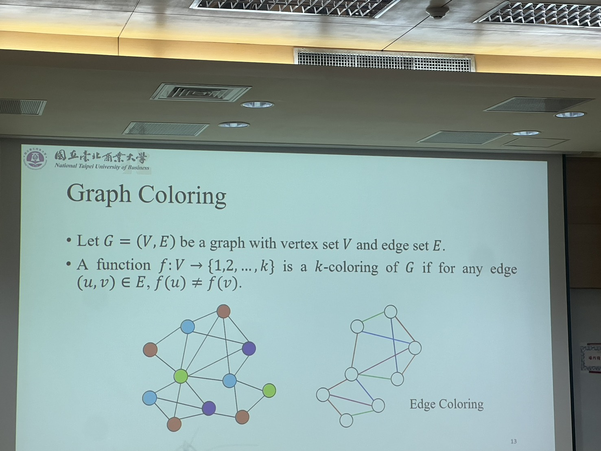
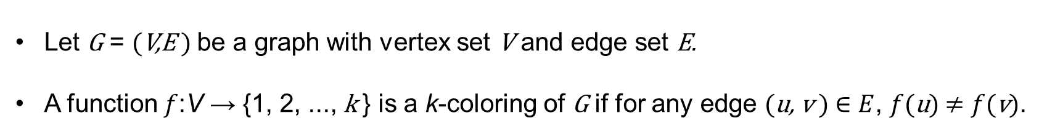
Keywords- Graph Coloring
Let G = (V,E ) be a graph with vertex set V and edge set E.
A function $f$:V → {1, 2, ..., k } is a k-coloring of G if for any edge (u, v ) $∈E$, $f$(u)$≠$ $f$(v).

Slide 12
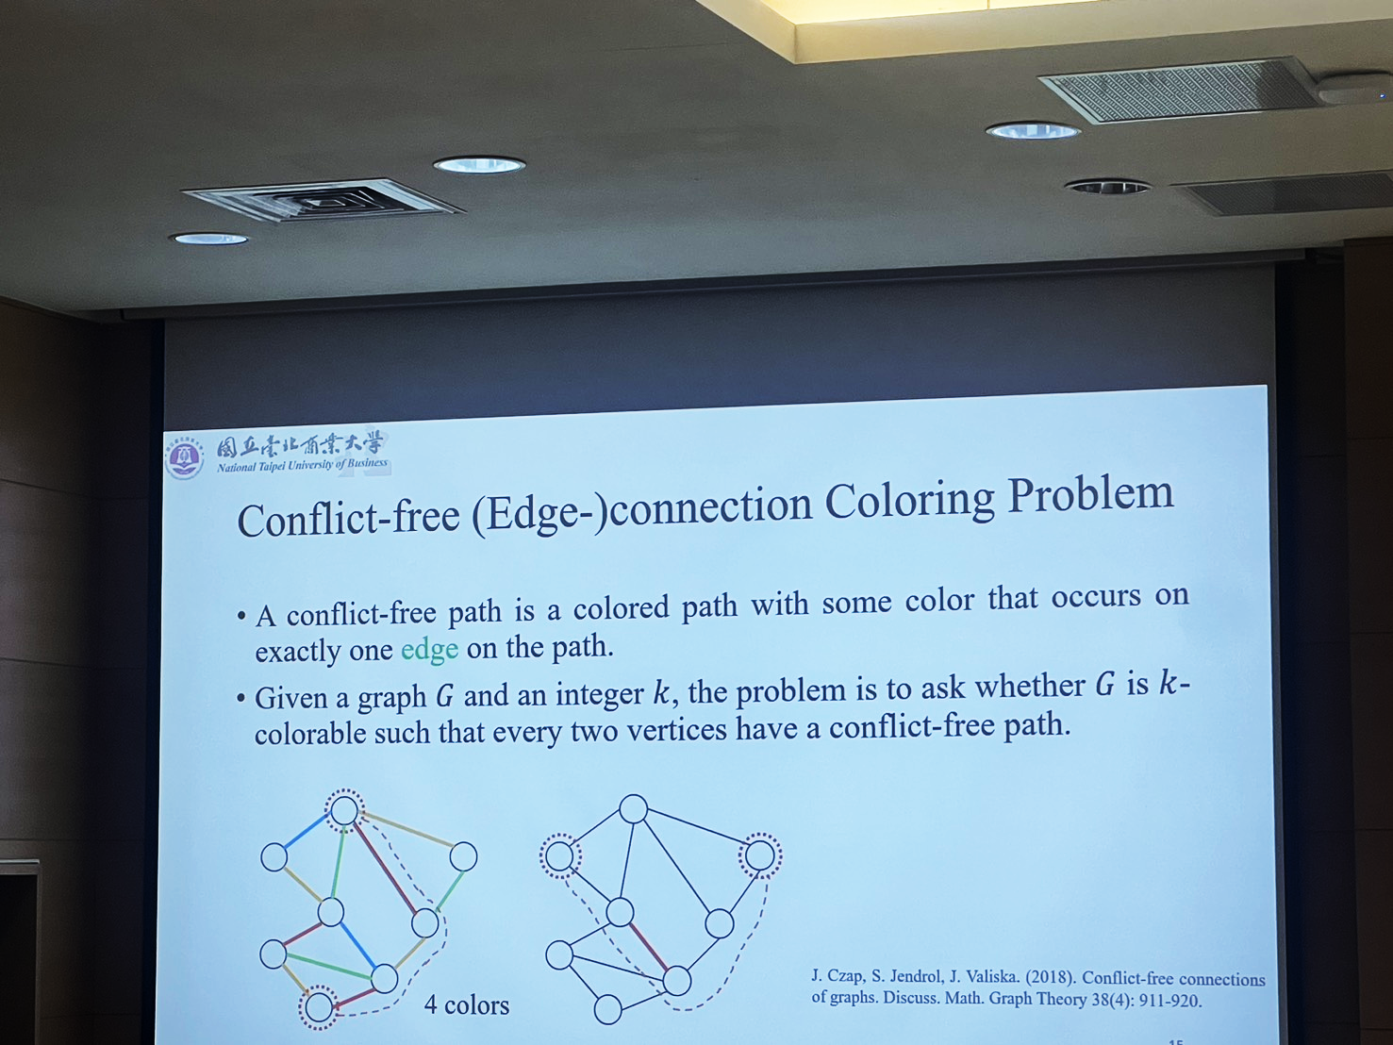
Keywords- Conducting a literature review
Conflict-free (Edge-)connection Coloring Problem
A conflict-free path is a colored path with some color that occurs on exactly one edge on the path.
Given a graph G and an integer k, the problem is to ask whether G is k-colorable such that every two vertices have a conflict-free path.
4 colors

Slide 13
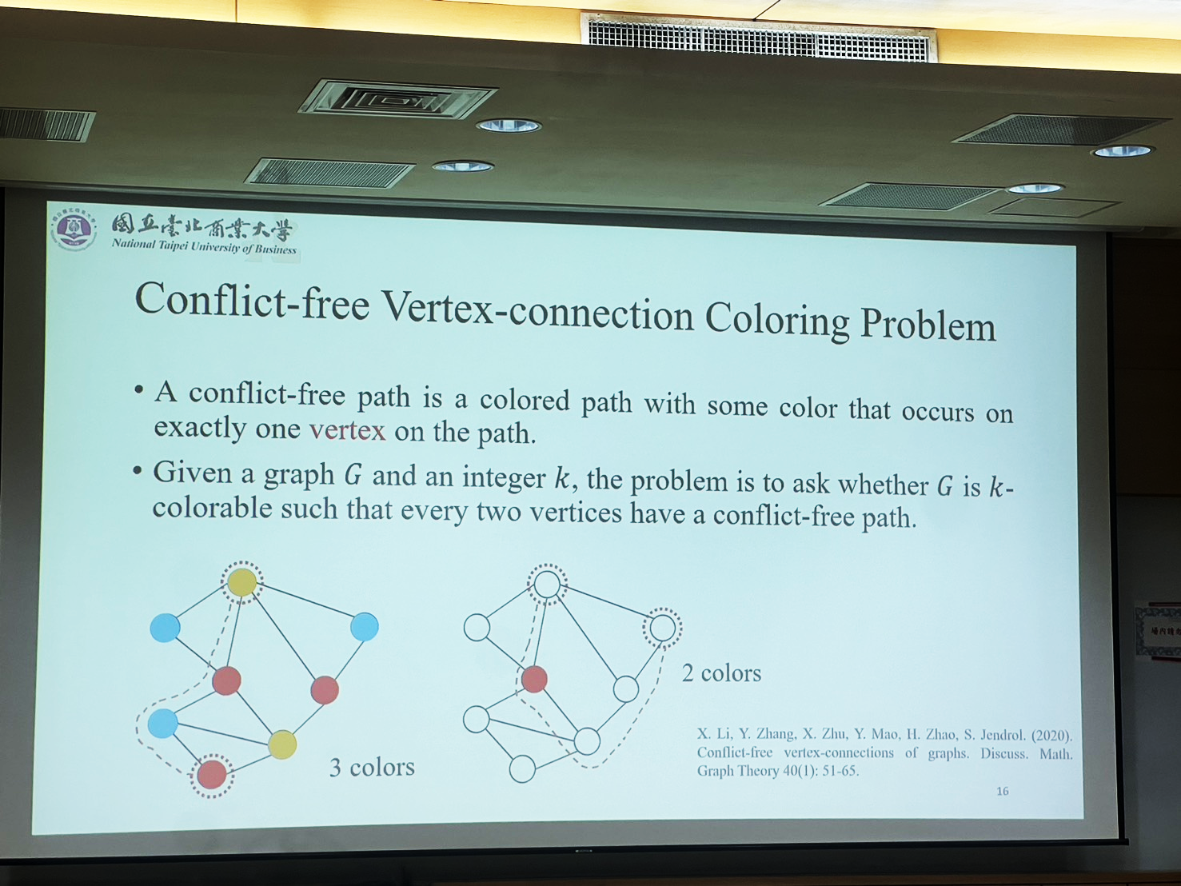
Keywords- Conducting a literature review
Conflict-free Vertex-connection Coloring Problem
A conflict-free path is a colored path with some color that occurs on exactly one vertex on the path.
Given a graph G and an integer k, the problem is to ask whether G is k-colorable such that every two vertices have a conflict-free path.
3 colors
2 colors

Slide 14
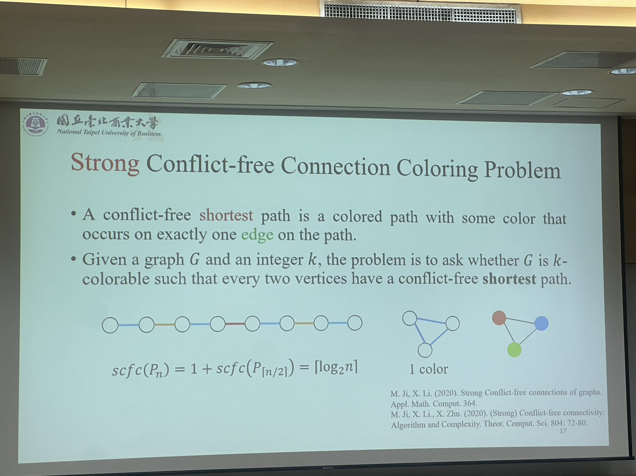
Keywords- Conducting a literature review
Strong Conflict-free Connection Coloring Problem
A conflict-free shortest path is a colored path with some color that occurs on exactly one edge one edge on the path.
Given a graph G and an integer k, the problem is to ask whether G is k-colorable such that every two vertices have a conflict-free shortest path.
1 color

Slide 15
Keywords- Conducting a literature review
Strong Conflict-free Connection Coloring Problem
 | Edge version | Vertex version
Connected by a path Conflict-free Connection Coloring Problem | [Czap et al., 2018] [Chang et al., 2019] [Chang et al., 2021] | [Li et al., 2020] [Li&Zhu, 2020] [Doan et al., 2021] [Doan et al., 2022]
Connected by a shortest path Strong Conflict-free Connection Coloring Problem | [Ji&Li, 2019] [Ji et al., 2020] | This study

Slide 16
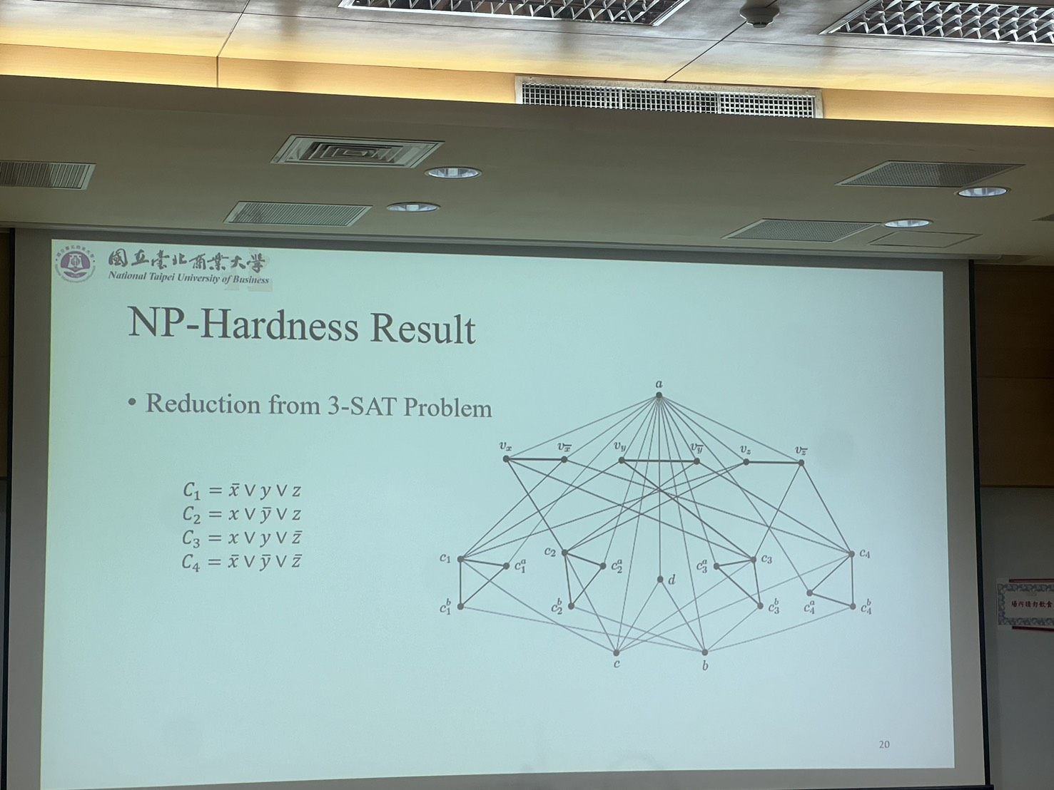
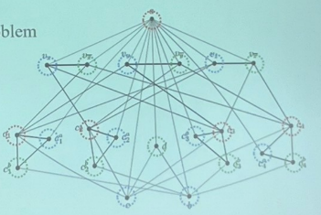

Keywords- Solving the problem
NP-Hardness Result
Reduction from 3-SAT Problem
Theorem: 3-svcfc problem is NP-Hard on 3-colorable graphs.

Slide 17
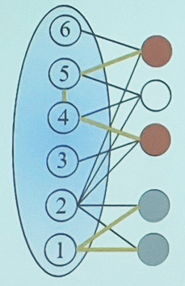
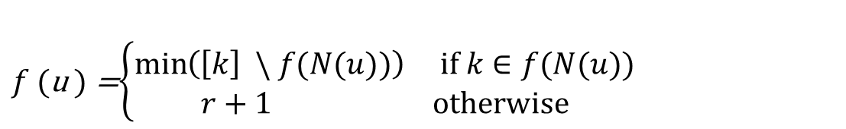
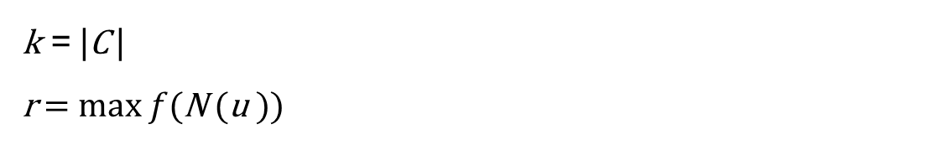
Keywords- Solving the problem
Polynomial Results
Split graphs
Clique: C
k = |C |
r = max $f$(N (u ))
$f$ (u ) =$\left\{\begin{aligned}\min\left(\left[k\right] \backslash f(N(u))\right) if k∈f(N(u)) \\ r+1 otherwise\end{aligned}\right.$

Slide 18
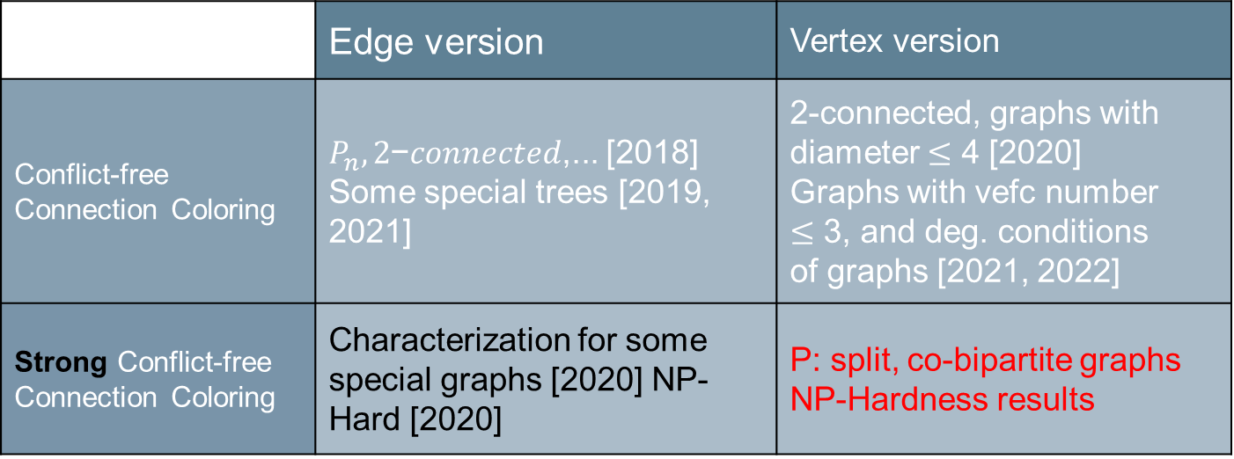
Keywords- Conclusion
 | Edge version | Vertex version
Conflict-free Connection Coloring | $P_{n}, 2$−𝑐𝑜𝑛𝑛𝑒𝑐𝑡𝑒𝑑,... [2018] Some special trees [2019, 2021] | 2-connected, graphs with diameter $≤$ 4 [2020] Graphs with vefc number $≤$ 3, and deg. conditions of graphs [2021, 2022]
Strong Conflict-free Connection Coloring | Characterization for some special graphs [2020] NP-Hard [2020] | P: split, co-bipartite graphs NP-Hardness results

Slide 19

Keywords- Conclusion
Writing a paper
Introduction
Conclusion
Preliminary / Previous Results
Why to do?
What to do?
How to do?
How good?
Analysis /Experiment
Our Method

Slide 20
Keywords- Conclusion
Related issues
Academic ethics
Plagiarism
Collaboration
Global cooperation
Academic events
Conferences
Academic service
Serve as a reviewer

Slide 21
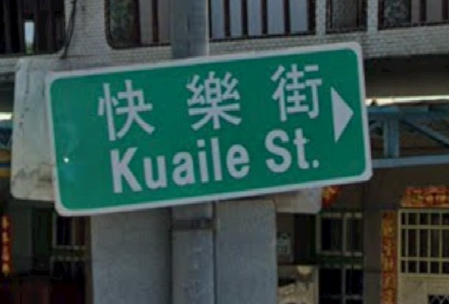
Keywords- Conclusion
Be patient
I do it, you can do it
Believe that you have an ability to do research
Be passionate
Just do it

Slide 22
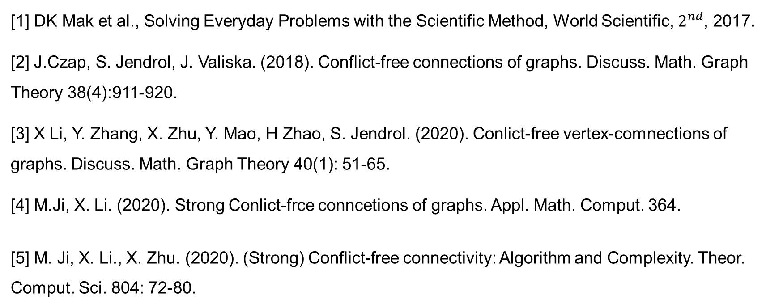
Keywords- Reference
[1] DK Mak et al., Solving Everyday Problems with the Scientific Method, World Scientific, $2^{nd}$, 2017.
[2] J.Czap, S. Jendrol, J. Valiska. (2018). Conflict-free connections of graphs. Discuss. Math. Graph Theory 38(4):911-920.
[3] X Li, Y. Zhang, X. Zhu, Y. Mao, H Zhao, S. Jendrol. (2020). Conlict-free vertex-comnections of graphs. Discuss. Math. Graph Theory 40(1): 51-65.
[4] M.Ji, X. Li. (2020). Strong Conlict-frce conncetions of graphs. Appl. Math. Comput. 364.
[5] M. Ji, X. Li., X. Zhu. (2020). (Strong) Conflict-free connectivity: Algorithm and Complexity. Theor. Comput. Sci. 804: 72-80.

